Slide 1
Digital Portfolio
STUDENT NAME: MOHAMED AATHIFKHAN. S
REGISTER NO AND NMID: 24BSAI235 & asbruag2428C0097
DEPARTMENT: BSc. AI&ML
COLLEGE: Sri Krishna Adithya College of Arts and Science

Slide 2
PROJECT TITLE
STUDENT PORTFOLIO

Slide 3


AGENDA
Problem Statement
Project Overview
End Users
Tools and Technologies
Portfolio design and Layout
Features and Functionality
Results and Screenshots
Conclusion
Github Link
3/21/2024 Annual Review

Slide 4

PROBLEM STATEMENT
In today’s digital world, having a personal portfolio is essential for students to showcase their skills, projects, and contact details in a professional way. Many students struggle to present their achievements and projects in an organized and attractive format. Without a portfolio, opportunities for internships, placements, and collaborations are limited. This project, “Student Portfolio”, aims to solve this problem by creating a simple, clean, and responsive portfolio website. It includes sections such as a personal introduction, an “About Me” with profile photo, a showcase of projects, and a “Contact Me” form. This structured design helps in effectively presenting a student’s profile, projects, and contact information in a single platform.

Slide 5

PROJECT OVERVIEW
The project “Student Portfolio” is a simple and responsive website that helps students present their skills, projects, and personal details in one place. It acts as a digital resume that can be shared with recruiters, teachers, and peers.
About Project:
This section introduces the student with a profile picture and a short description. It highlights who the student is and gives a quick personal background.
Projects:
The portfolio displays major works in a neat way. For example:
Project 1: CGPA Calculator – A tool to calculate students’ overall academic performance from grades and credits.
Project 2: Chat Box – It enables real-time text communication between users.
Project 3: Student Portfolio – A personal portfolio website showcasing details.

Slide 6
Skills:
This section shows the student’s technical and soft skills. Examples: HTML, CSS, JavaScript. Web development basics, Problem-solving and creativity.
Contact:
A contact form allows others to reach the student easily. It includes name, email, contact number, and a message box with a Send option.
Main Idea:
The main idea of the project is to create a digital identity for students where they can showcase their skills, projects, and achievements in a professional and organized way. This helps in career opportunities, networking, and personal branding.

Slide 7

END USERS
Students – To showcase their skills, projects, and personal details in a professional way.
Recruiters / Companies – To quickly review the student’s profile, skills, and projects for hiring or internship opportunities.
Teachers / Mentors – To evaluate student achievements and guide them for improvement.
Peers / Classmates – To collaborate, get inspired, or exchange project ideas.
General Audience – Anyone who wants to know about the student’s work, skills, or background.

Slide 8
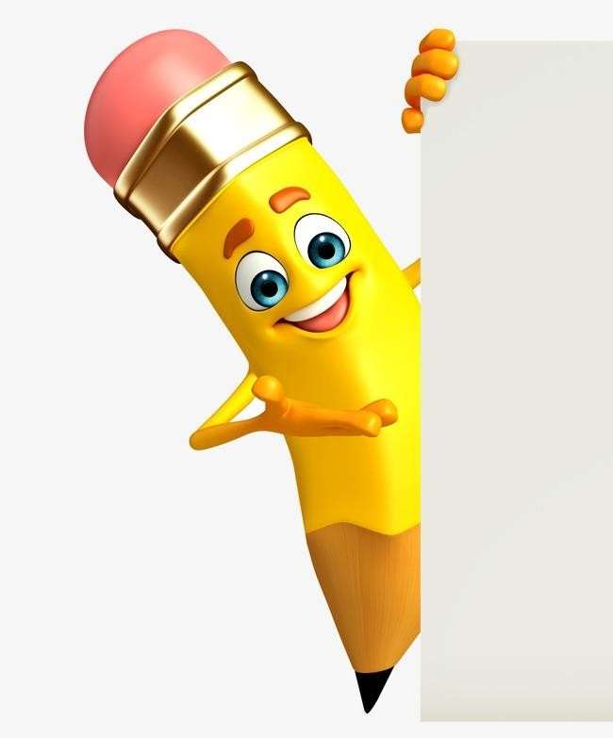
TOOLS AND TECHNIQUES
  HTML (Hyper Text Markup Language) – Used to create the structure and content of the portfolio (headings, paragraphs, images, forms).
  CSS (Cascading Style Sheets) – Used for styling the portfolio with colors, layouts, fonts, and responsiveness.
  JavaScript – Used to add interactivity like smooth scrolling, form handling, and button actions.
4. CodePen – An online IDE where the project is created and tested with separate panels for HTML, CSS, and JS.
5. Responsive Design Techniques – Media queries and grid layouts are used to make the website mobile-friendly.
6. UI/UX Design Principles – To ensure the portfolio is clean, attractive, and easy to navigate.

Slide 9
POTFOLIO DESIGN AND LAYOUT
The portfolio is designed in a vertical single-page layout, where each section is placed one after another for easy scrolling and navigation. The layout is clean, simple, and user-friendly.
Header / Hero Section :
Contains the portfolio title “Student Portfolio”, a hello statement, a short selfintroduction, and a “View My Work” button.
About Me Section – Displays a profile photo along with a single-line description about the student.
Projects Section :
Showcases three projects (Error Detector, Web Development, Student Portfolio) in horizontal boxes, making the work visually clear.
9

Slide 10
Skills Section:
Highlights the technical and soft skills of the student.
Contact Section – Includes a form with Name, Email, Contact Number, Message box, and a Send button for easy communication.
Footer Section:
Provides the copyright note with the student’s name. The layout follows a modern, responsive design, ensuring it works well on desktops, tablets, and mobile devices.

Slide 11
FEATURES AND FUNCTIONALITY
Simple User Interface – A clean and attractive design that makes navigation easy for viewers.
Responsive Layout – The portfolio adjusts automatically to different screen sizes (desktop, tablet, mobile).
Hello and Introduction Section – Gives a quick overview of the student with a “View My Work” button for smooth navigation.
About Me Section – Shows the student’s profile picture and a short personal description.
Projects Showcase – Displays three main projects in neatly arranged boxes with titles and details.
Skills Display – Highlights the technical and personal skills of the student.
Contact Form – Allows users to send messages by entering name, email, contact number, and message.
Interactive Elements – JavaScript features like smooth scrolling and form handling improve user experience.
Footer Section – Displays copyright information with the student’s name and the current year.

Slide 12
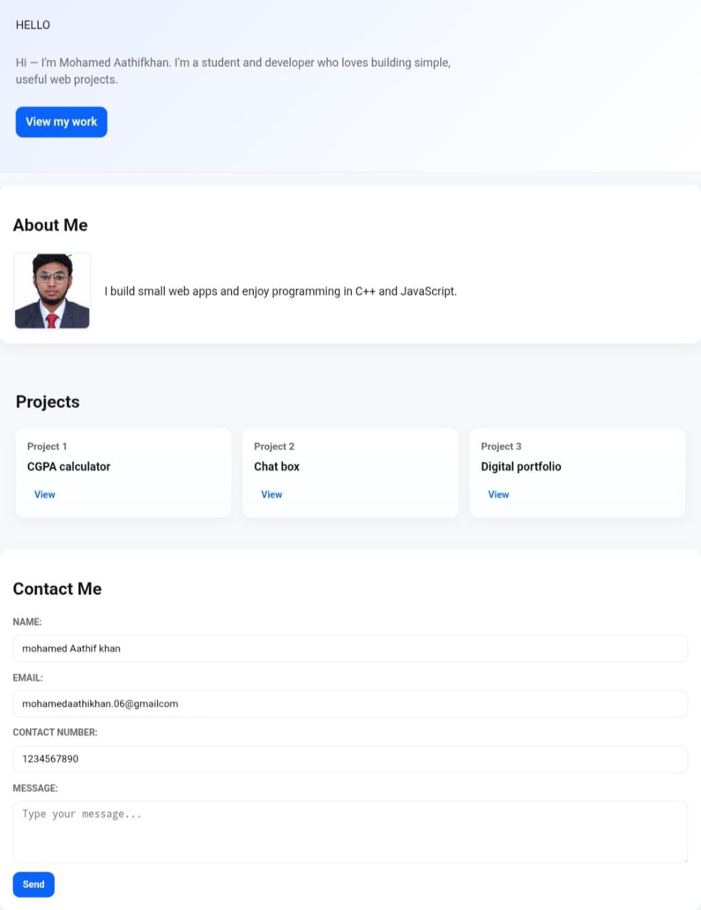

RESULTS AND SCREENSHOTS
12

Slide 13
CONCLUSION
Highlights of the Project:
personal digital portfolio designed with HTML, CSS, and JavaScript.
Includes key sections such as About Me, Projects, Skills, and Contact.
User-friendly, responsive design that works across all devices.
Interactive features like smooth scrolling and form handling for a better experience.
Final Summary:
The Student Portfolio project provides a structured and professional way for students to present their personal details, skills, and projects online. It acts as a modern digital resume that is simple, responsive, and effective in showcasing one’s achievements. By combining design and functionality, this portfolio helps create strong personal opportunities and collaborations.
13

Slide 14
GITHUB LINK
https://github.com/24bsai235mohamedaathifkhans-ship-it/MOHAMED-Aathif-Khan-.git

